Slide 1
Comparison of Sudoku Solving Algorithms

Slide 2
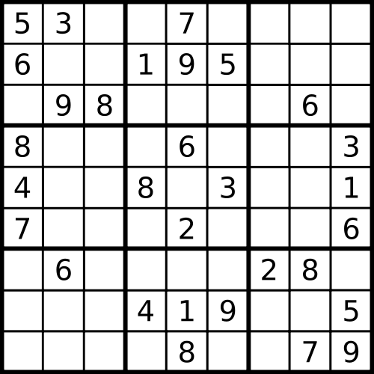
Introduction: What is Sudoku?
Row
Column
3x3 Box

Slide 3
Aims/ Objectives
Aim: that takes a range of sudoku solving algorithms and compares them using a range of difficulty of puzzles. Compare and contrast
Objectives:
Explore current methods of sudoku solving and select 3
Establish test data for comparison of algorithms
Select sudoku solving algorithms to implement
Develop test bed to allow comparison of algorithms
Implement alorithms
Evaluate implemented sudoku algorithms at multiple complexities
State of the art sudoku solving tools evaluate selection

Slide 4
Research so far
Backtracking
Stochastic Algorithms

Slide 5
Next step
Investigate different stochastic algorithms: randomly assigning numbers to empty cells, shuffle number methods.
Sudoku test bed and sudoku creation research / implementation
Algorithm implementation
Write up

Slide 6
Timeline

Slide 8
References
https://www-cdf.fnal.gov/~qgliu/Misc/sudoku.html
Animation By Simpsons contributor - Program written in Java, letter images made in Photoshop, CC BY-SA 3.0, https://commons.wikimedia.org/w/index.php?curid=29034832

